Slide 1
BATTERY MANAGEMENT SYSTEM
A smart monitoring approach to predict battery health, aging, and failure risk before issues occur on the road.

Slide 2
PROJECT OVERVIEW
WHAT ARE WE BUILDING
We are developing a predictive prototype that monitors key systems in a vehicle and alerts the driver before failures occur. In this project, we are focusing on the Battery Management System (BMS), which is the most critical and foundational component.

Slide 3
SUB-SECTIONS
GOAL
Predict battery problems early
Use real-time battery health %, temperature, and charge cycle data
CURRENT SCOPE :
BMS module is implemented
Other systems (engine, brakes, tyres) will be added later
OUTCOME :
A clear State of Health (SOH) value
Helps understand battery condition at any moment

Slide 4
IMPORTANCE OF BATTERY HEALTH
Around 70% of EV system failures are related to batteries
Battery issues can directly affect performance and safety
Early detection helps avoid sudden breakdowns
Helps drivers understand risks in advance
Improves overall reliability of the vehicle

Slide 5
INPUT PARAMETERS
These parameters give a real-time view of how the battery is functioning.
By analyzing them together, we can estimate battery health and detect potential issues early
TEMPERATURE
VOLTAGE
CURRENT
BATTERY HEALTH TEMPERATURE
CHARGE CYCLE COUNT

Slide 6
IMPACT OF TEMPERATURE ON BATTERY AGEING
0–10°C | Factor 1.2 | Cold, slower chemistry, higher resistance
10–20°C | Factor 1.1 | Slightly cold
20–30°C | Factor 1.0 | Ideal range
30–40°C | Factor 1.4 | Warm, faster aging
40–50°C | Factor 2.0 | Hot, aging doubles

Slide 7
REAL-TIME OBJECTIVES
Continuously monitor battery parameters
Detect abnormal patterns early
Provide timely warnings to the driver
Estimate battery State of Health (SOH) accurately
Improve battery lifespan by preventing harmful conditions

Slide 8
TECHNICAL INSIGHTS
Prototype-based approach
Uses sensor data for monitoring
Focus on predictive analysis
Designed for future scalability
Can be extended to full vehicle health system

Slide 9
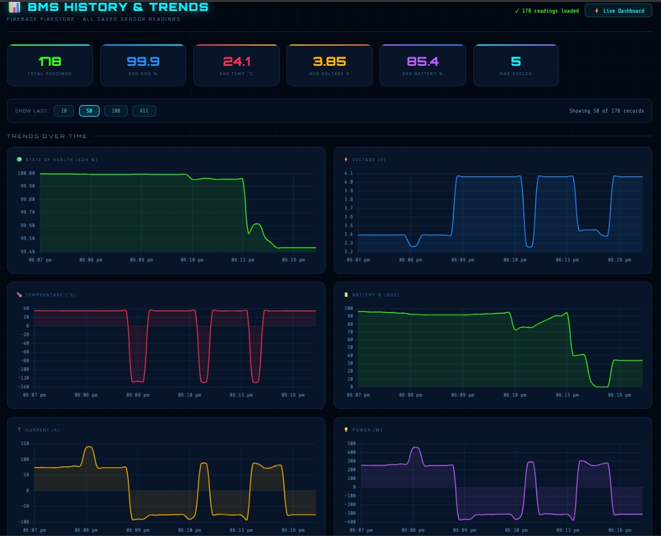
RESULTS

Slide 10
CONCLUSION & LEARNINGS
Battery health monitoring is critical for EV safety
Predictive systems can reduce unexpected failures
Temperature plays a major role in battery aging
Simple data can provide powerful insights
Scope for further expansion and improvement

Slide 11
THANK YOU!

